Slide 1

Ola Ride Insights

Slide 2
Objectives
Analyze ride booking patterns
Evaluate vehicle type performance
Measure customer satisfaction
Understand cancellation behavior
Provide data-driven insights
Develop an interactive dashboard

Slide 3
Visual aids
(Dashboards)

Slide 4
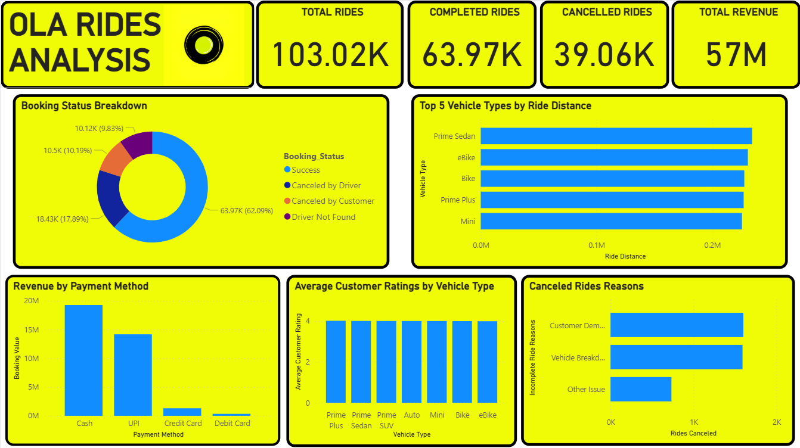
Dashboard 1

Slide 5
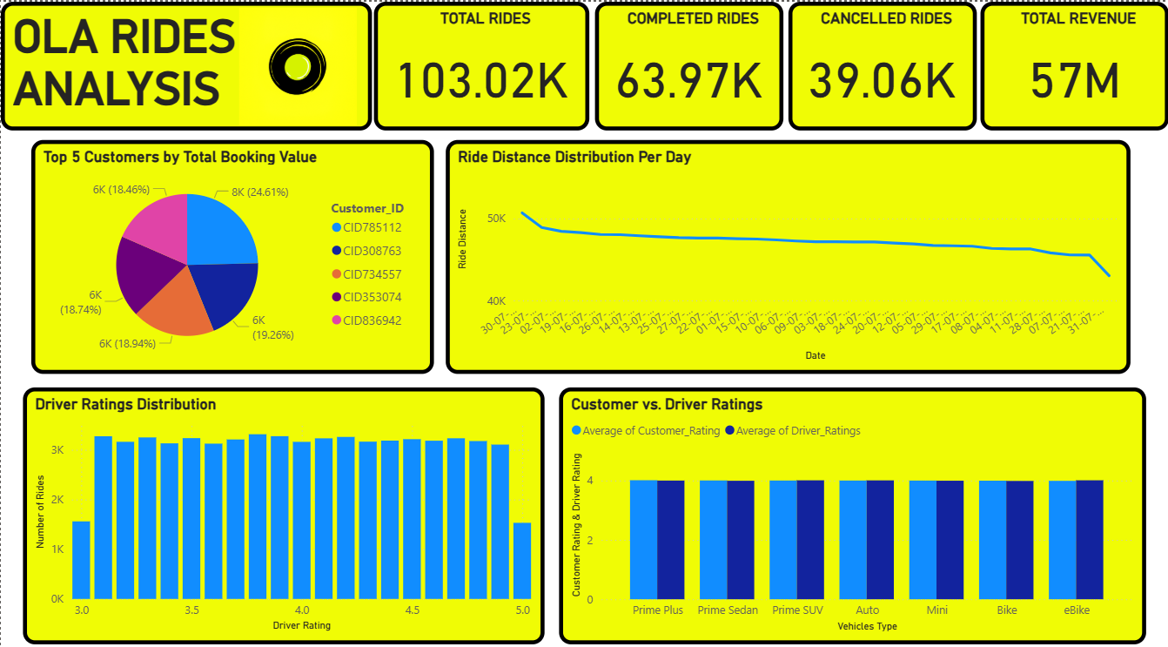
Dashboard 2

Slide 6
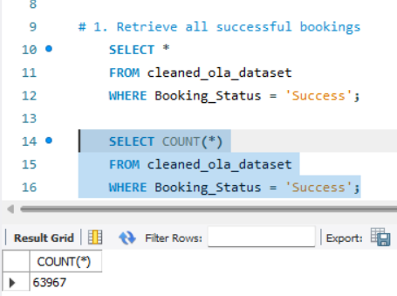
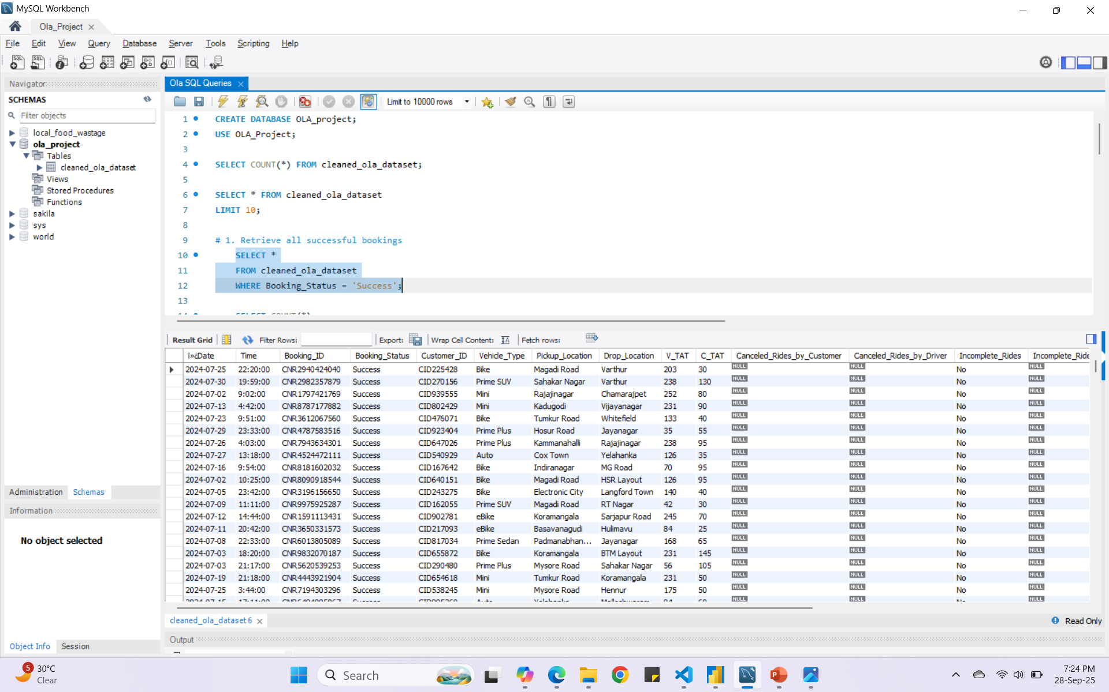
SQL Insights
1. Retrieve all successful bookings

Slide 7
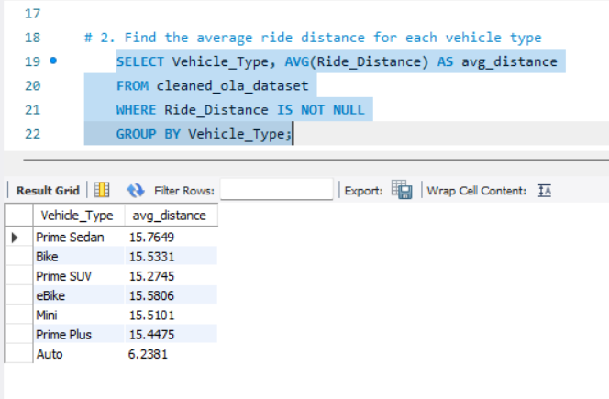
2. Find the average ride distance for each vehicle type

Slide 8
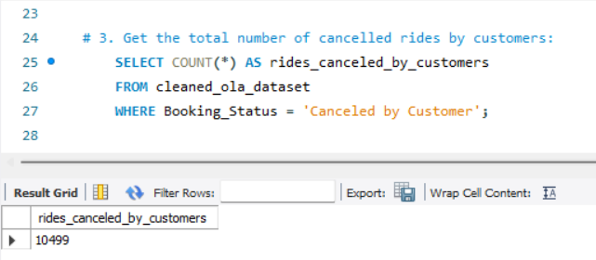
3. Get the total number of cancelled rides by customers

Slide 9
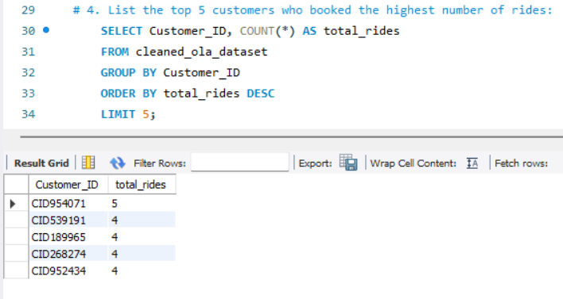
4. List the top 5 customers who booked the highest number of rides

Slide 10
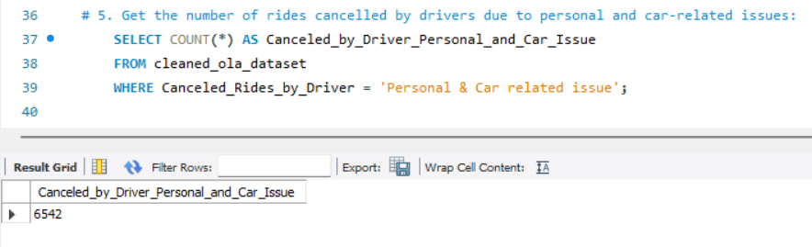
5. Get the number of rides cancelled by drivers due to personal and car-related issues

Slide 11
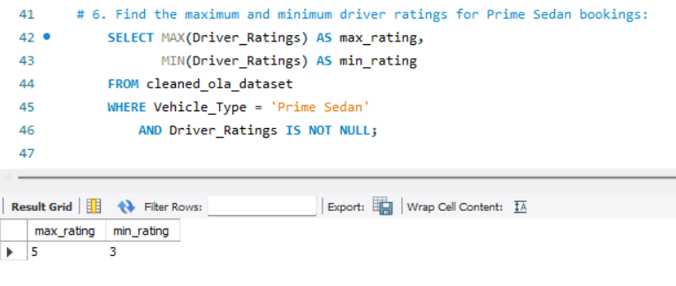
6. Find the maximum and minimum driver ratings for Prime Sedan bookings

Slide 12
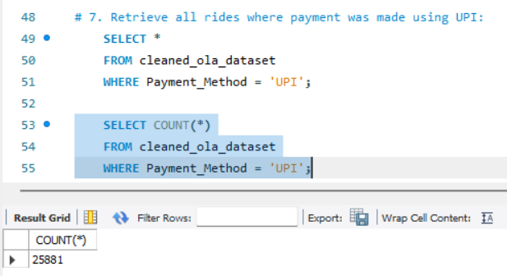
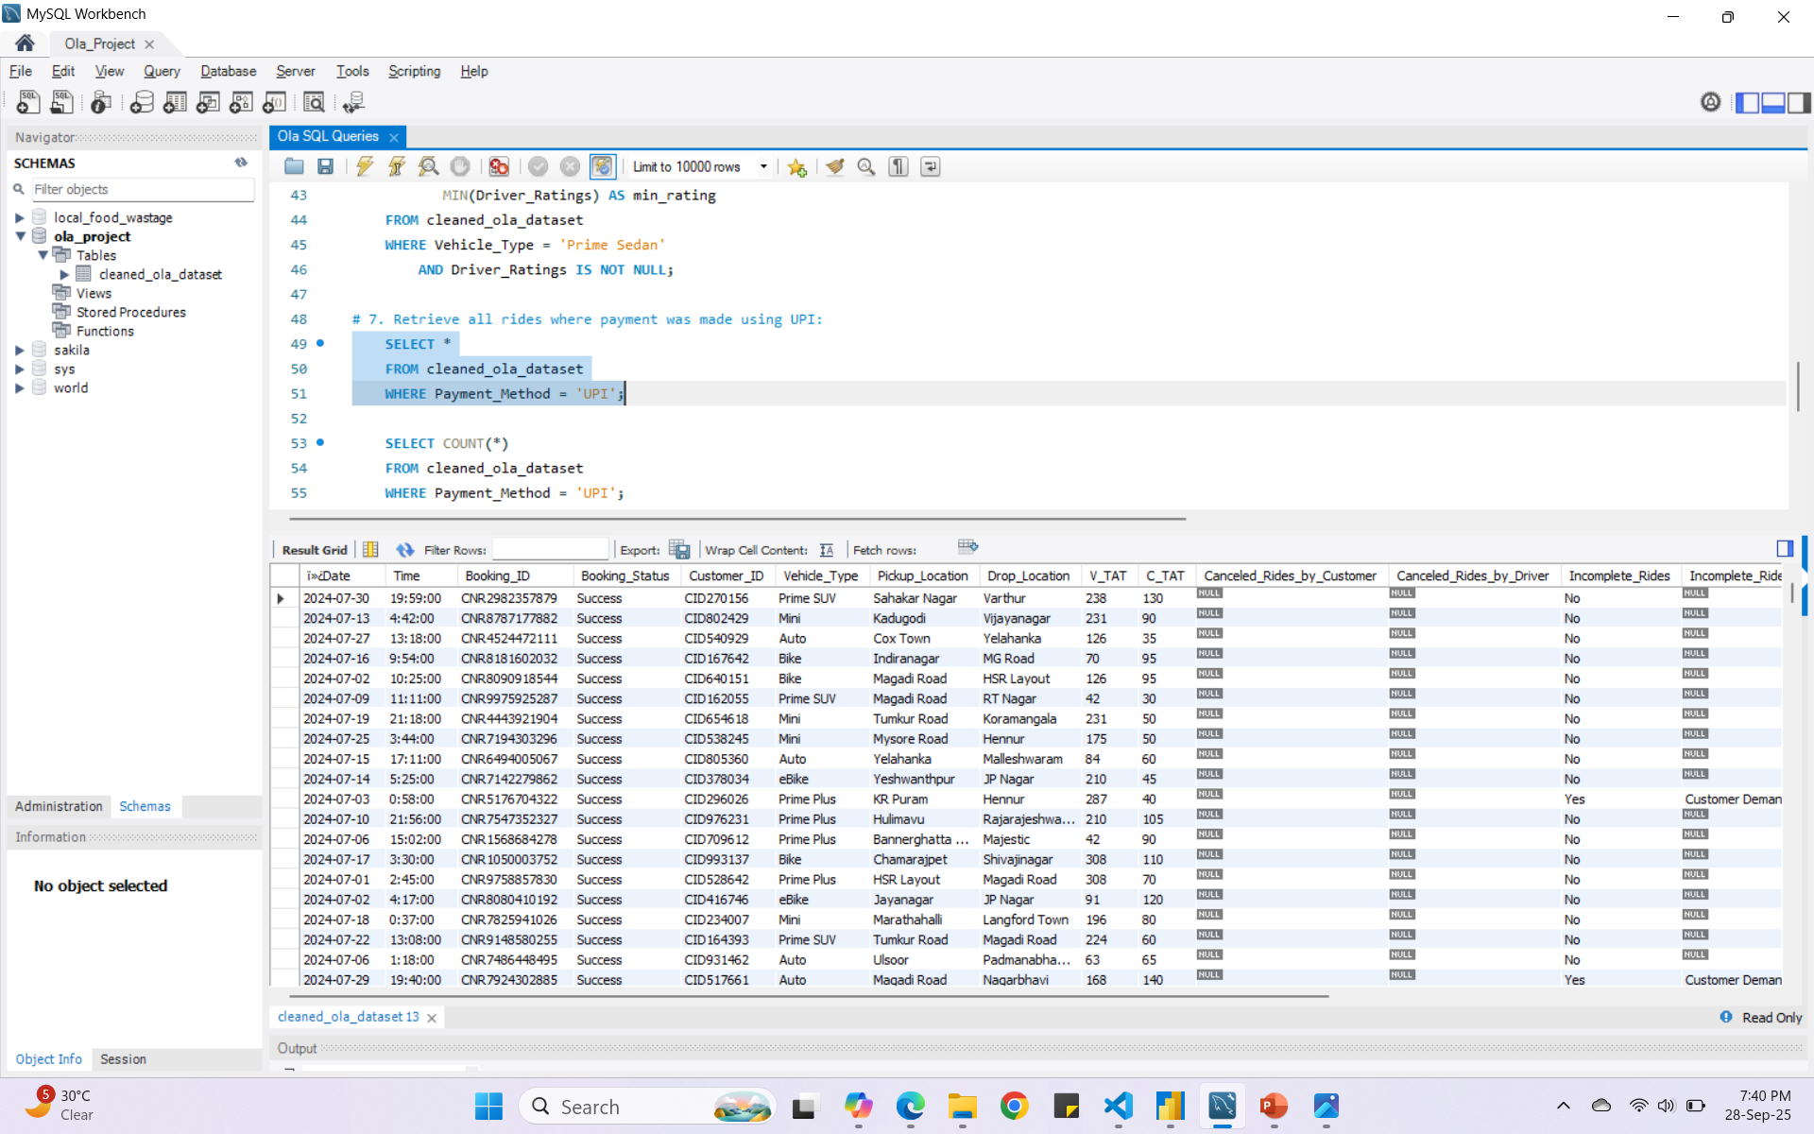
7. Retrieve all rides where payment was made using UPI

Slide 13
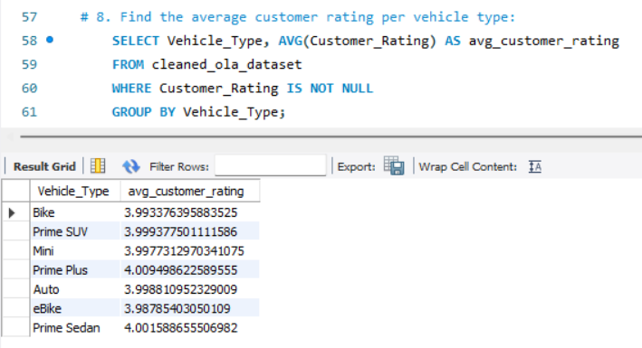
8. Find the average customer rating per vehicle type

Slide 14
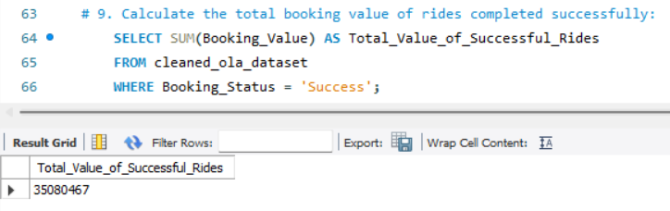
9. Calculate the total booking value of rides completed successfully

Slide 15
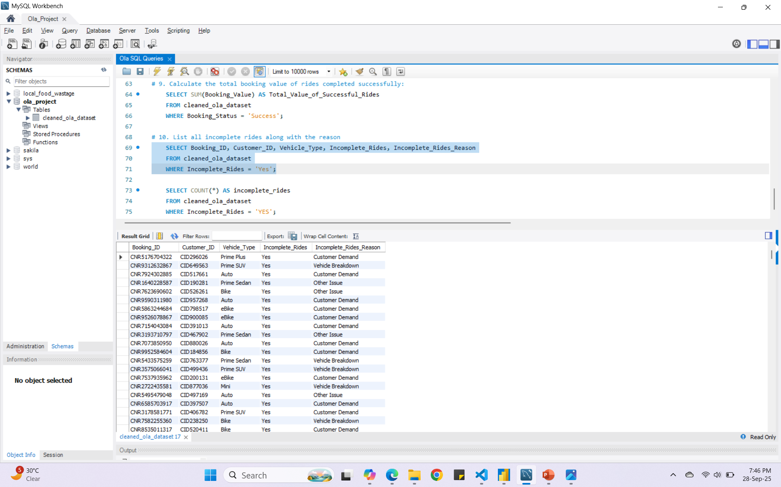
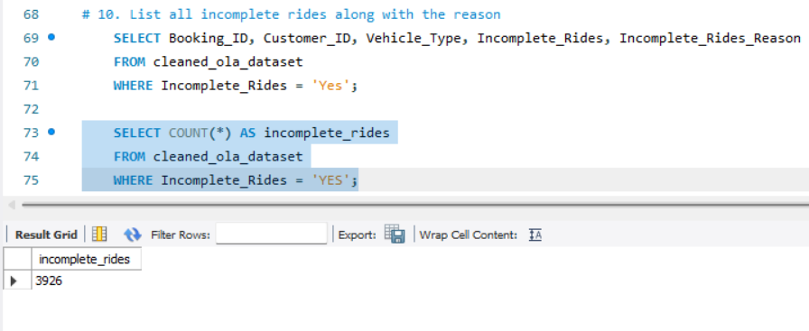
10. List all incomplete rides along with the reason

Slide 16
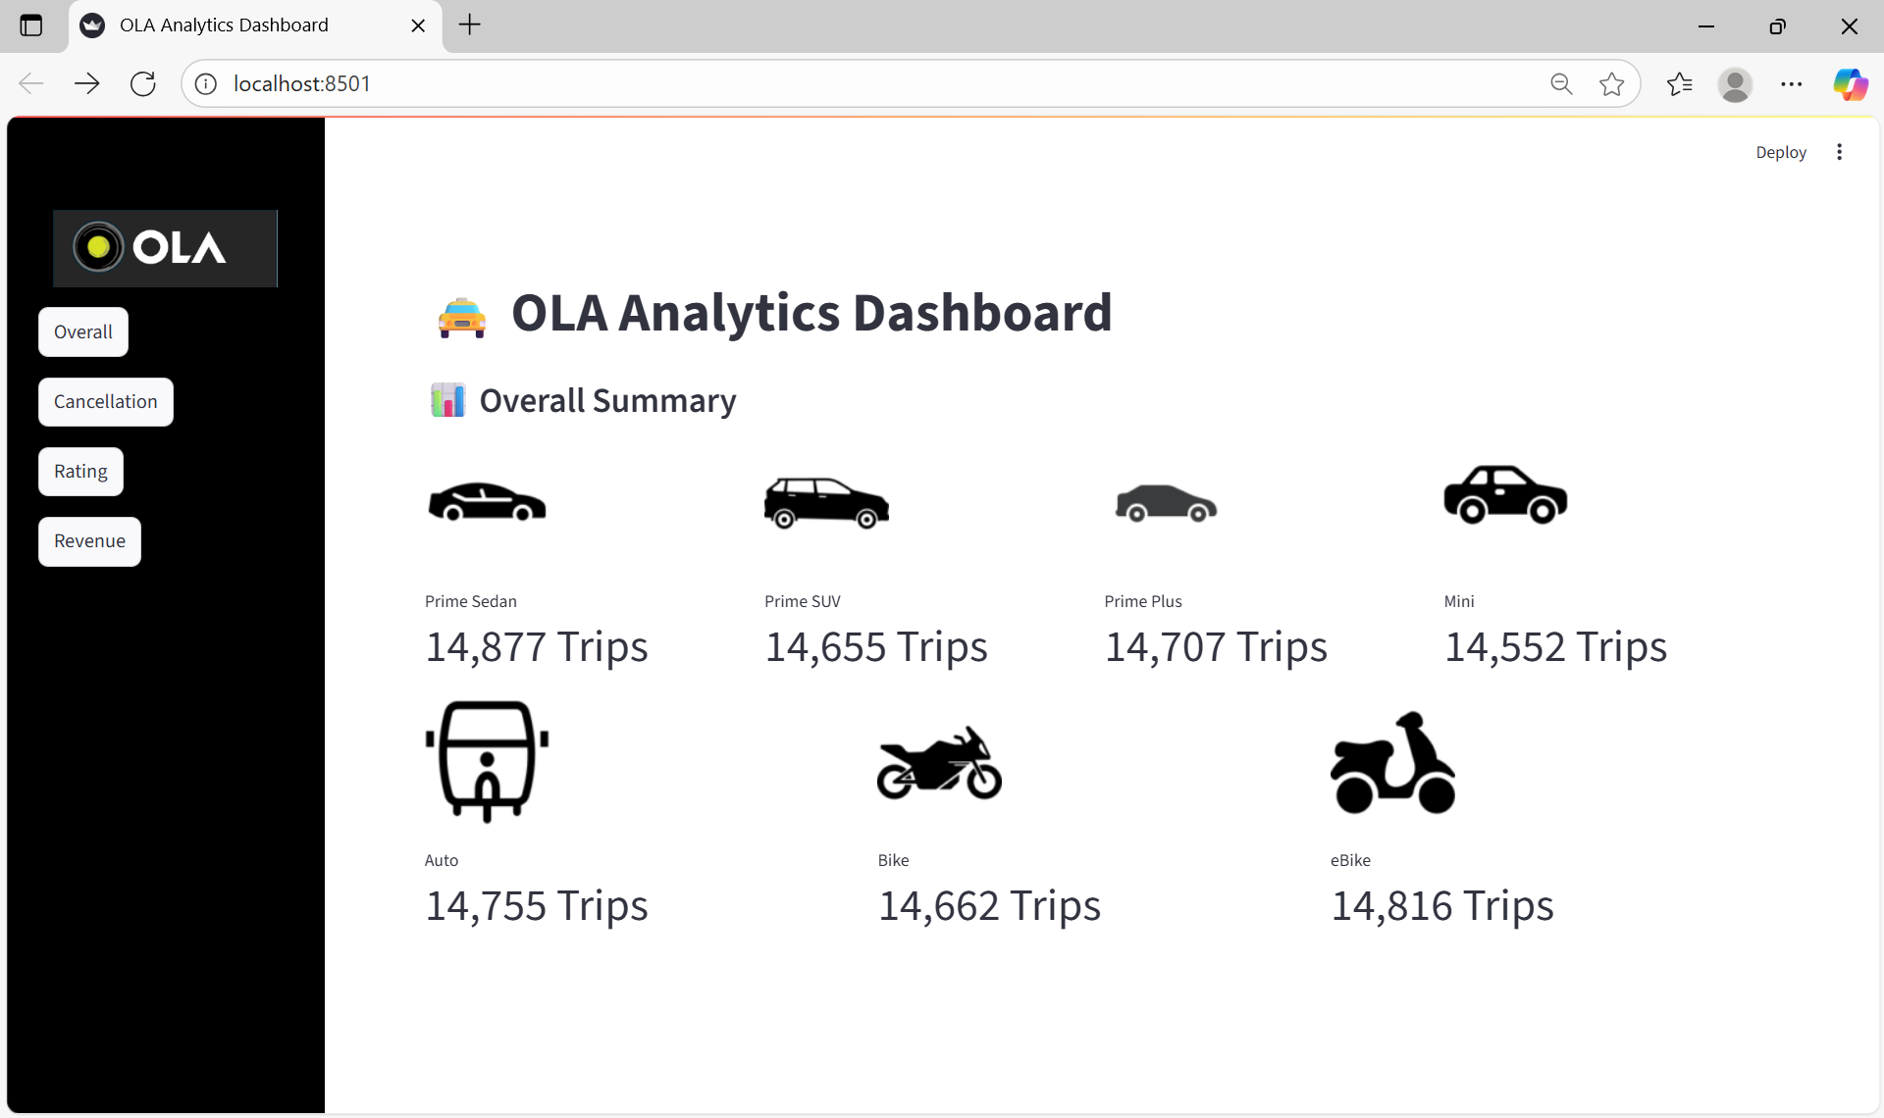
Streamlit

Slide 17
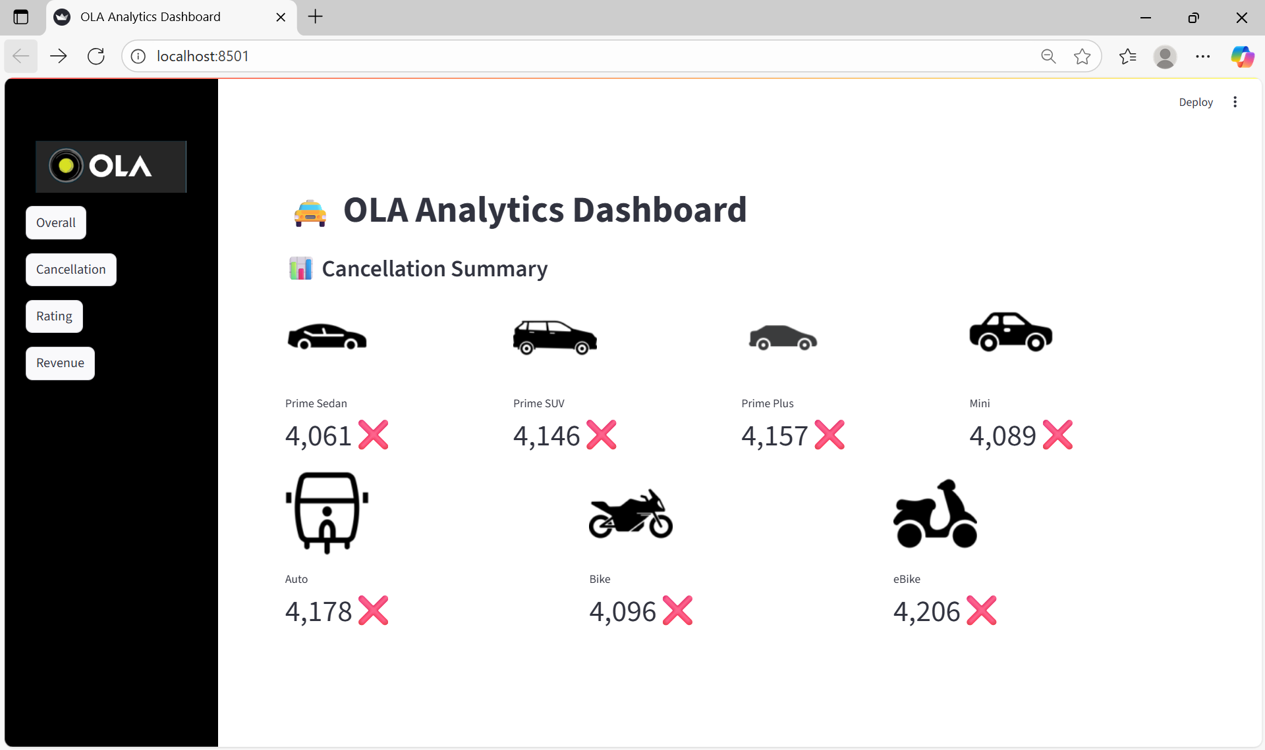

Slide 18
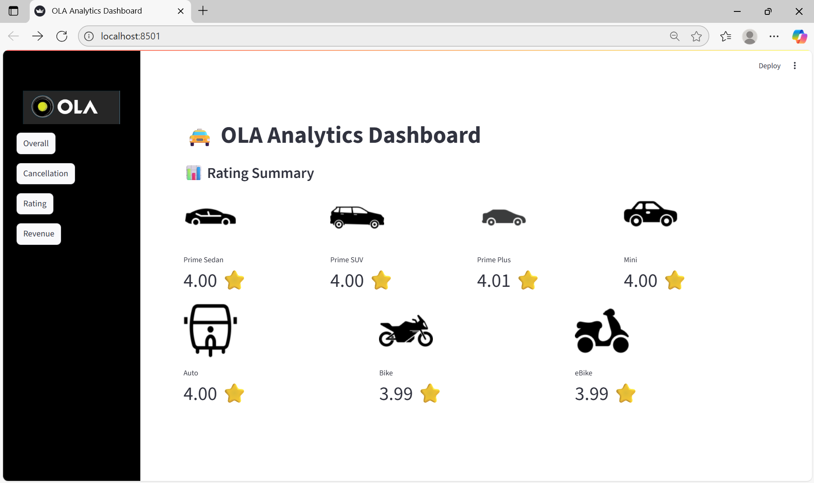

Slide 19
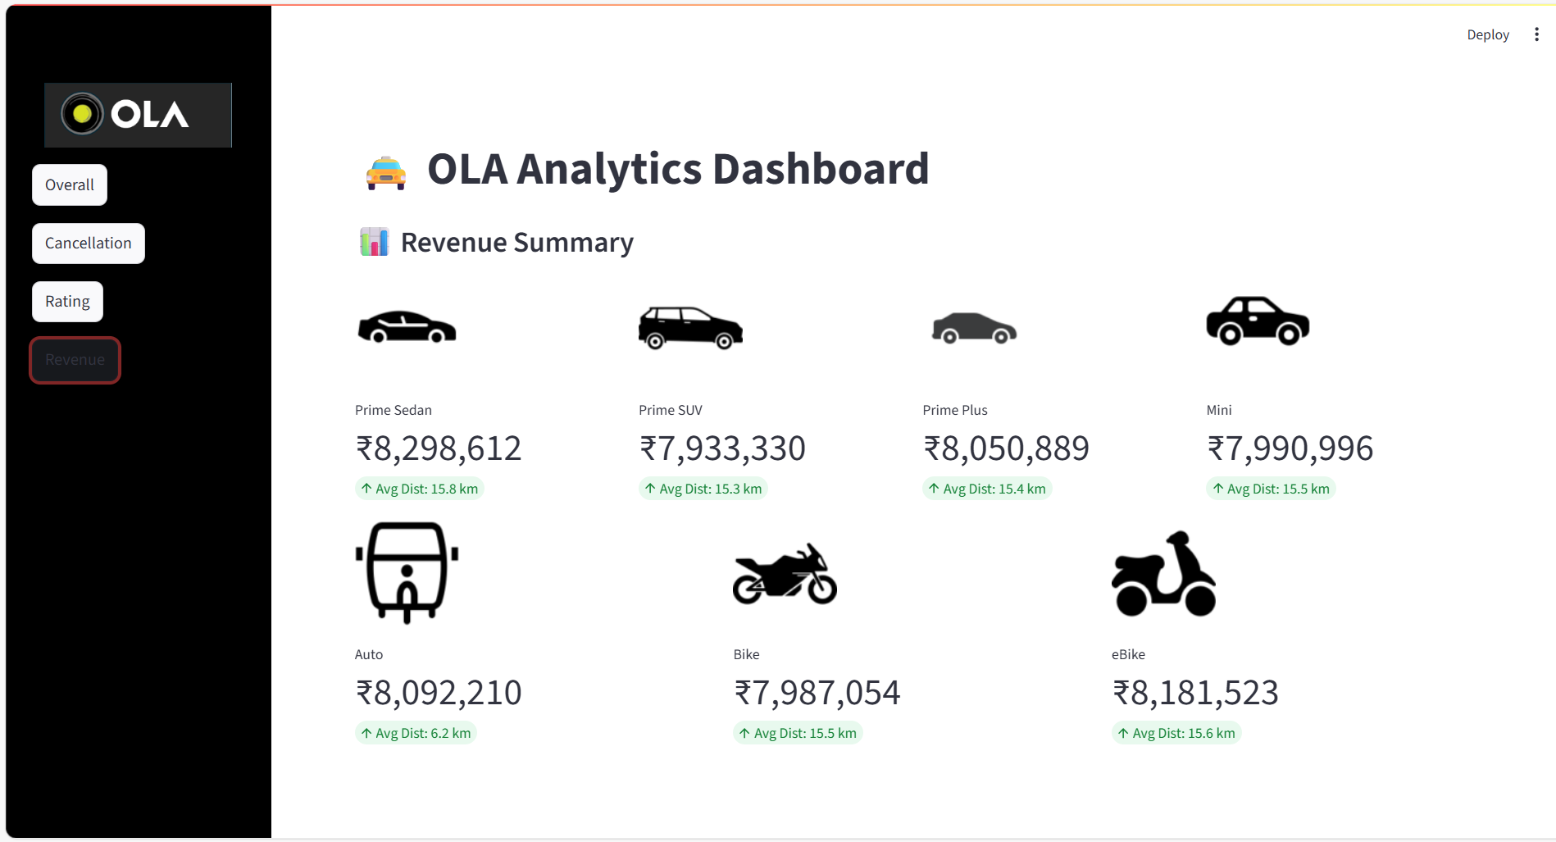

Slide 20
Insights and Recommendations
Revenue Contribution – Prime Sedan and Prime SUV generated the highest booking value.
Customer Ratings – Auto and Bike rides had relatively lower average ratings compared to premium vehicles.
Cancellations – A significant number of cancellations were due to drivers, especially for short-distance rides.
Demand Patterns – Mini and Bike were more popular in shorter rides, while Prime Sedan and SUV dominated long-distance bookings.
Recommendations:
Incentivize drivers during peak hours to reduce cancellations.
Improve service quality in Auto and Bike categories to enhance customer ratings.
Optimize vehicle availability based on ride distance and demand patterns.
Promote premium vehicles like Prime Sedan and SUV to boost revenue.

Slide 21
Thank you
Himanshu
Domain- Data Analyst
hiimanshuu0406@gmail.com

